Slide 1

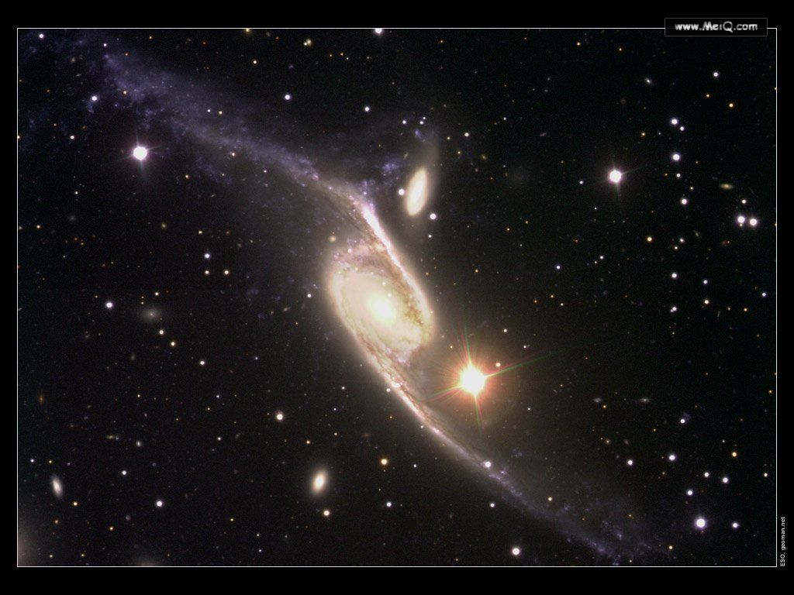

Module 5
The Conquest of the Universe

Slide 2
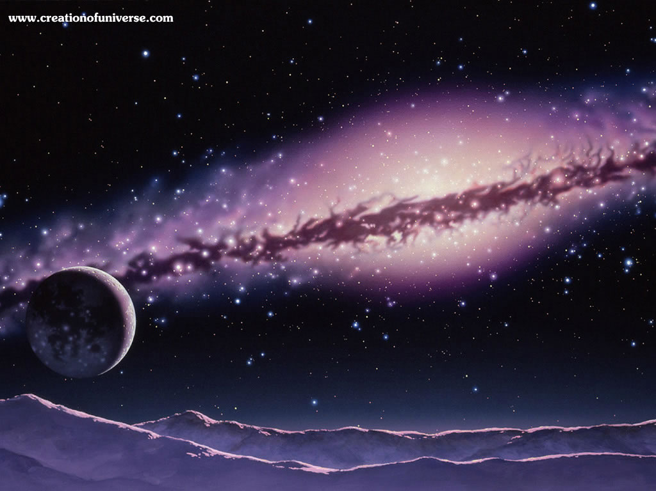
Speaking
Look at the picture. Find out some topics which you are interested in to debate.

Slide 3
Choices
（1）Should we continue to send people into space?
（2）Is it necessary to continue space exploration?
（3）Is it necessary for a country to try to land on the Moon?
（4）Should more money be spent on space exploration?

Slide 4
Activity
3
For:
Against:
Points | Details
1. 2. ...
Points | Details
1. 2. ...

Slide 5
Expressions
Supporting an opinion:
I think that..., because...
One reason is that...
For example...
I’m sure that...
It is worth while doing...
The fact is that...
Why...is that....

Slide 6
Expressions
Challenging an opinion:
Have you thought about...?
Could you explain...?
Perhaps, but what if/ about...?
However, I think it doesn’t worth the effort.
It’s a waste of money/energy doing...
What you say is...

Slide 7
Cultural Corner
strange beings; aliens; a dramatic story; fantasy story; not realistic

Slide 8
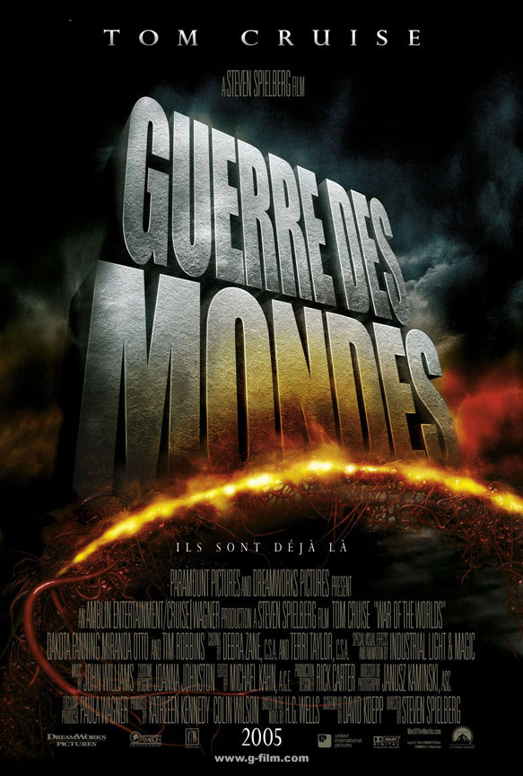
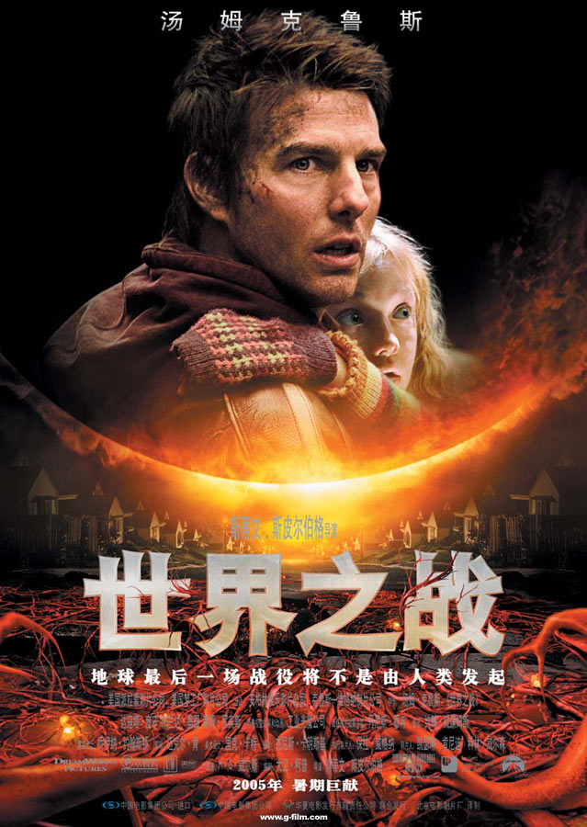
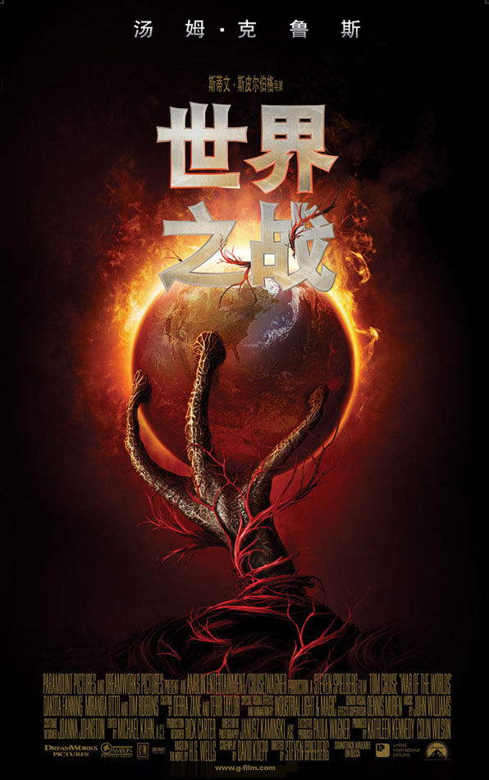
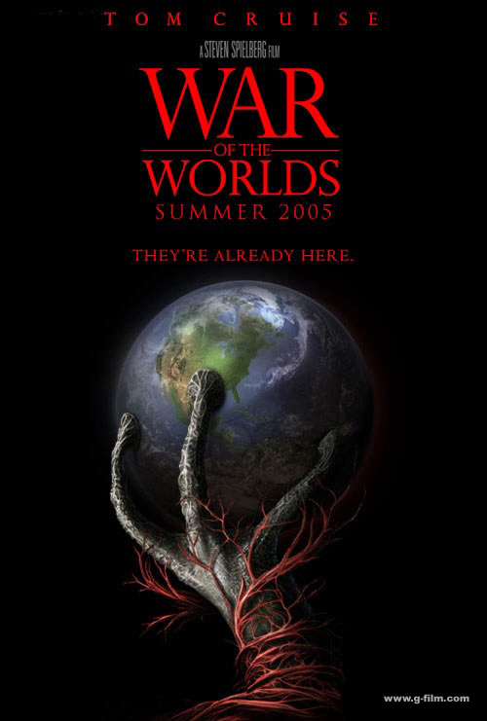
Brainstorming
The War of the Worlds

Slide 9
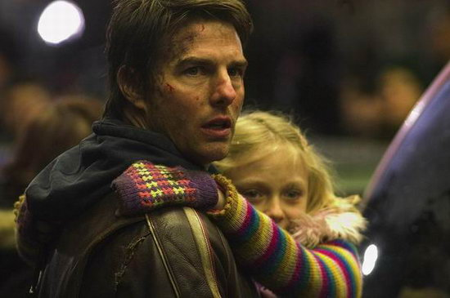
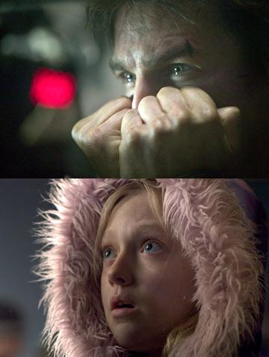
set a panic across the country in motion; in panic; a wave of mass hysteria

Slide 10
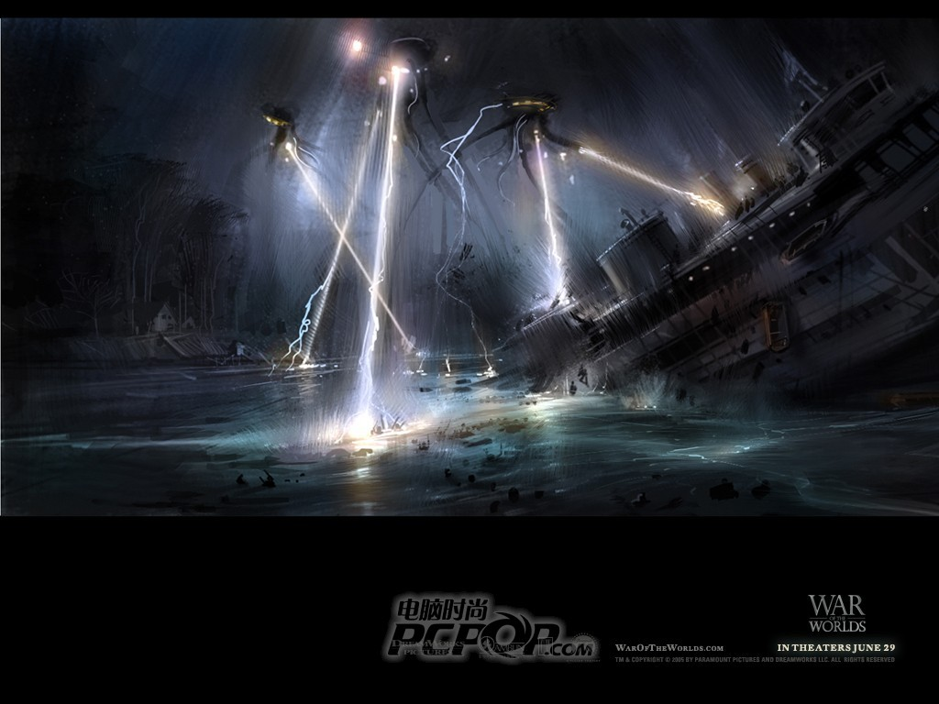
terrifying; make great impact on; invade (invasion)

Slide 11
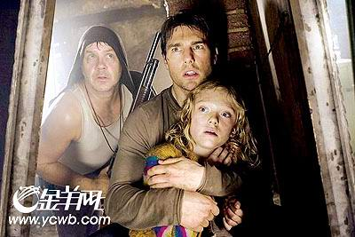
defend (defense)

Slide 12
H.G.Wells (1866~1946) 现代科幻小说之父 威尔斯
1904 《诸神的食粮》Food of the Gods
1901 《登上月球的第一批人》The First Men in the Moon
1899 《当沉睡者苏醒》When the Sleeper Wakes
1898 《世界大战》The War of the Worlds
1897 《隐形人》The Invisible Man
1896 《莫洛博士岛》The Island of Dr. Moreau
1895 《时光机》The Time Machine
1895 《奇异的探访》The Wonderful Visit

Slide 13
Reading Comprehension
（1）Who is the writer of The War of the worlds?
（2）What is the story about/
（3）In 1938, what did Orson Wells do about it?
（4）How did people respond when hearing the radio drama?
（5）What does the writer think of the radio drama?

Slide 14
Who is the writer of The War of the worlds?
What is the story about?
In 1938, what did Orson Wells do about it?
The English writer H. G. Wells.
It’s about an invasion of the earth by aliens from Mars.
Wells set a radio drama of the War of the Worlds in the real life New Jersy town of Grover’s Mill.

Slide 15
How did people respond when hearing the radio drama?
What does the writer think of the radio drama?
People were terrified and got into panic.
In the author’s opinion, It made great impact and will be remembered as a piece of broadcasting history.

Slide 16
Post-reading
What have you learned in the text? Report it in your own words.

Slide 17
This passage mainly tells us about the War of the Worlds, which was a novel written by The English writer H. G. Wells and later was adapted into a radio drama by an American actor and director. The radio drama set the story in real life and if was life-like, causing a panic across America. It’s a successful science fiction drama and will be remembered as a piece of broadcasting history. It has been filmed by the famous director Spielberg. Lots of people are fascinated by its overwhelming scenes.

Slide 18
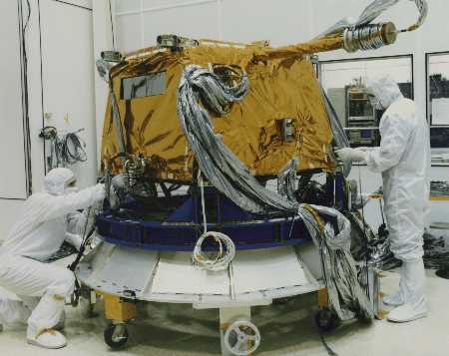
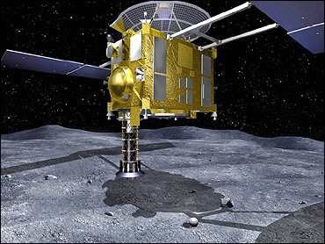
Reading and Vocabulary (2)
telescope
Brainstorming
the probe

Slide 19
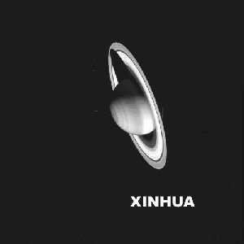
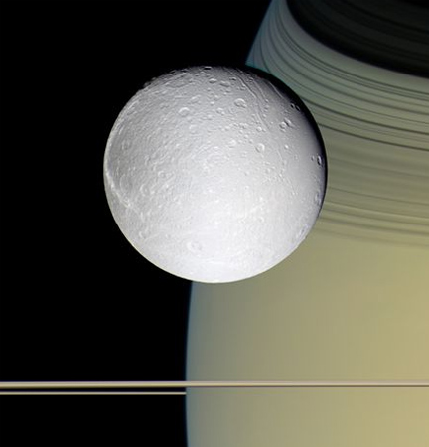
picture of Santurn sent back by Huygens
卡西尼宇宙飞船10月11日拍摄的这张图片显示的是土星和土卫四(Dione)。图片中央是土卫四，远处较大的星球是土星。卡西尼宇宙飞船在距土卫四表面310英里以内的上空飞行，照片清晰的显示卫星表面有许多撞击形成的凹坑，但没有大气层。

Slide 20
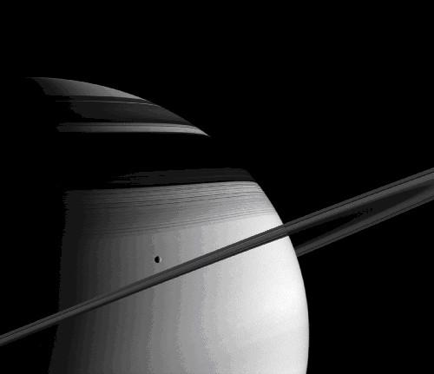
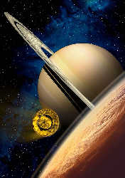
an imaginary image of the Huygens(惠更斯号探测器) flying to the moon of Saturn.
这是“飞向土星的卫星―土卫六的想象图。 Cassini 飞船于1997年10月携带着“惠更斯”号发射升空，迄今已遨游太空7年多。
Saturn (seen from the universe)

Slide 21
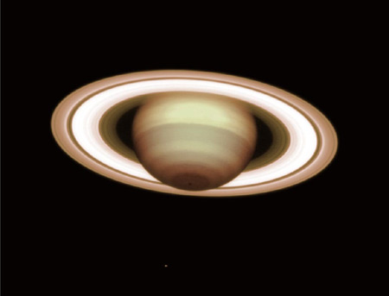
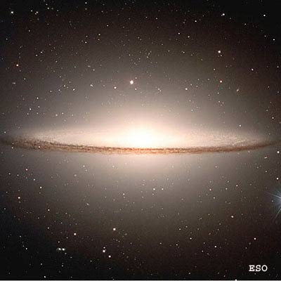
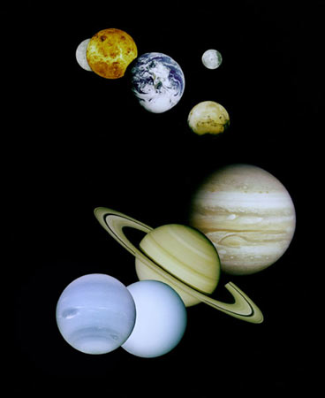
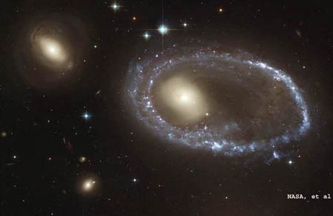
Secrets of the Gas Giant

Slide 22
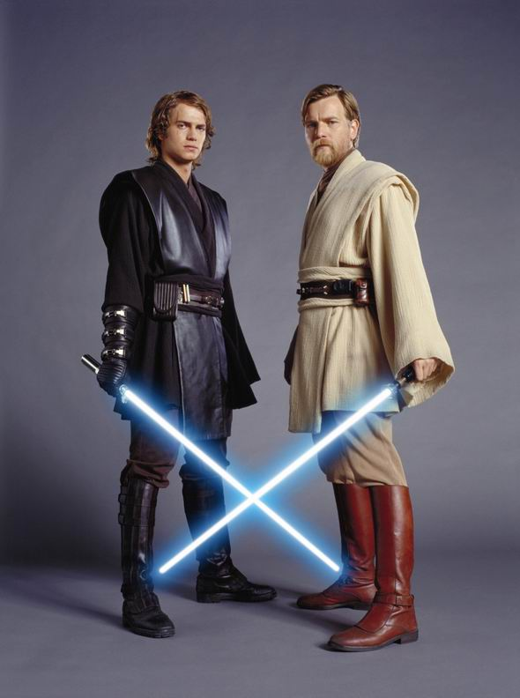
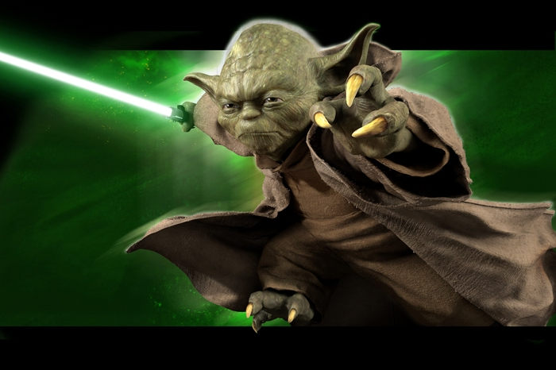
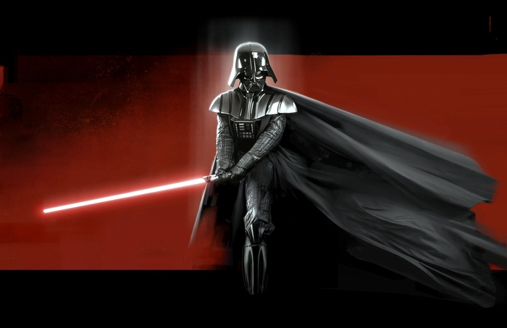
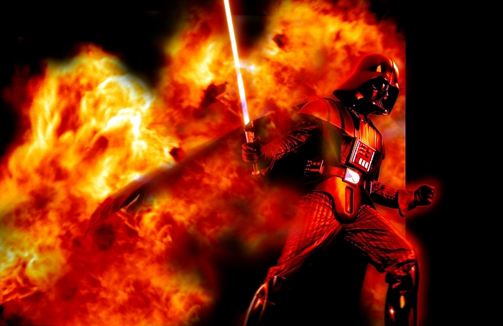
Star wars

Slide 23
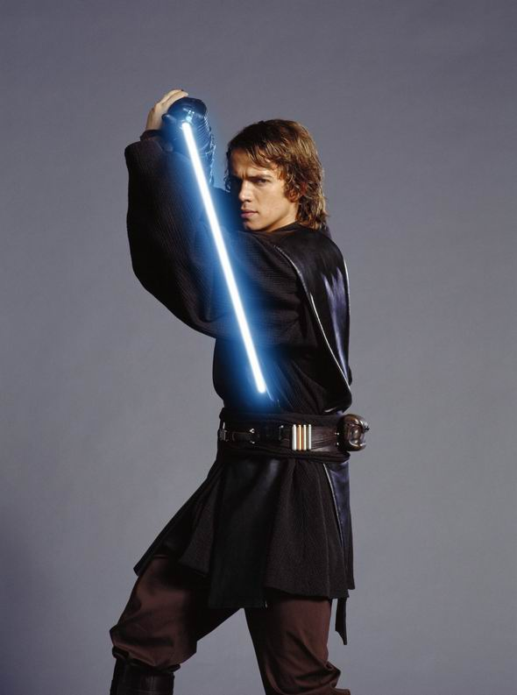
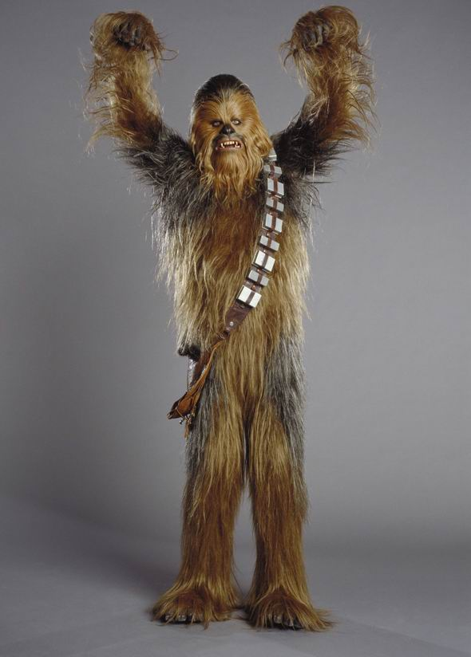
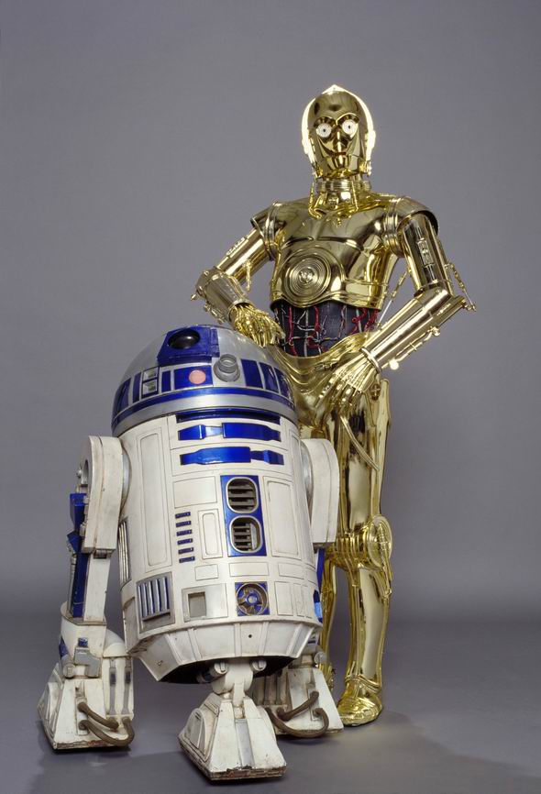
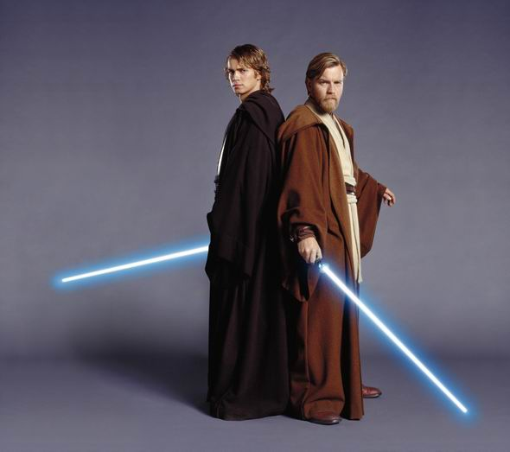
Star wars

Slide 24
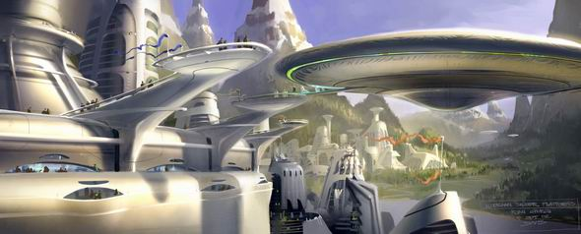
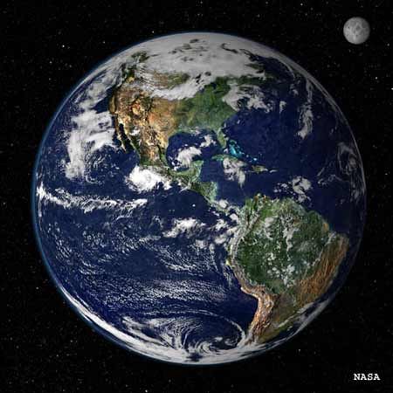

Slide 25
Skimming
activity
1
(1) Saturn
(2) Saturn’s moons
2
1. a newspaper article
the last one
3

Slide 26
Para 1: The description of photos of Saturn and its rings.
Para 2: The mission of the Cassini-Huygens space probe.
Para 3: The description of photos of Titan and Phoebe.

Slide 27
4
（1）To explore Saturn and its rings and moons.
（2）In shades of blue, green and red.
（3）Likely to be a mixture of water and frozen gases.
（4）Gases. （5）Because it is so light.
（6）In 1997.（7）Two of Saturn’s moons.
（8）Its shape.
（9）It has liquid on the surface.
（10）They are very clear, and yet come from so long a distance.

Slide 28
（1）d
（2）g
（3）f
（4）e
（5）a
（6）c
（7）b
5

Slide 29
6
（1）Mostly facts, but “amazing” suggests the opinion.
（2）Mostly facts, but “is likely to be” shows an opinion.
（3）Fact.
（4）Mostly facts, except “strange” which suggests the writer’s opinion.

Slide 30

Tips: A fact is a piece of information that can be proved, something real, and something exists. An opinion is a belief or conclusion held with confidence but not proved by positive knowledge or proof.

Slide 31
Writing
1
（1）present perfect tense.
（2）Past simple / present simple / present continuous / simple future tense
（3）He gives new information in each paragraph.
（4）Present simple tense.
（5）He compares them with the Earth and our moon.

Slide 32
 | para | keys words
1. main news | para 1. sentence 1; para 4, the whole sentence
2. extra details | para 1, sentence 2
3. the history | para 2, sentence 1&2
4.surprising fact | para 1, last two sentences
5. expert opinion | para 3, sentence 1; para 4
6. the future | para 3, sentence 2
2

Slide 33
Writing
The international space probe has landed on Mars after a journey of six months. It is sending the first photos of the dark side of the planet. The photos are clear enough to show the different colors of the rings which shows that the surface of the dark side of the planet is rocky and is surrounded by frozen gases.

Slide 34
The probe is an international project and was first launched in 1996 and this is the sixth landing on Mars. Its mission was to explore Mars on which scientists are wondering if there is life.
Scientists say the spacecraft’s 9-year tour may tell them the planet may have had life forms in the past. In order to study the planet’s atmosphere and resources, it is predicted that manned mission will be made in ten years.

